Slide 1
Computer System Overview
Covers Chapter#01 from Textbook

Slide 2
Outline
Operating System
Example of Instruction Execution
The Memory Hierarchy
Interrupts
Basic Elements of Computer System
Instruction Execution

Slide 3

Operating System
An operating system (OS): is a software that exploits the hardware resources to provide a set of services to system users.
The OS manages the processor(s), memory and input/output (I/O) devices on behalf of its users.
It is important to have some fundamental understanding of the computer system hardware before we begin our examination of operating systems.

Slide 4
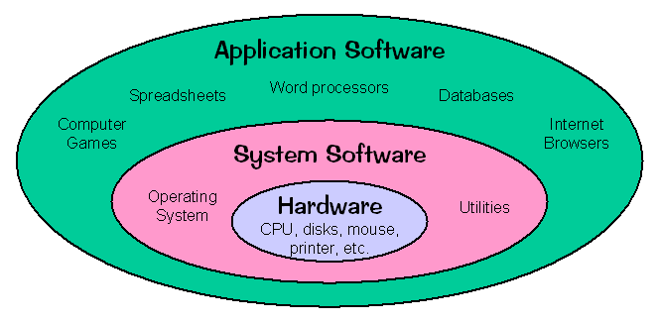
Operating System (Cont.)
Fig: The relationship between application software and system software.

Slide 5
Basic Elements of Computer System
In a computer system, there are four main structural elements:
Processor: Controls operation of the computer and performs its data processing functions.
Main memory (primary memory): Stores data and programs.
Main memory, and is typically volatile.
Disk memory, and is nonvolatile.
I/O modules: Move data between the computer and its external environment, e.g. storage (harddisk).
System bus: Provides communication among processors, main memory and I/O modules.

Slide 6
Basic Elements of Computer System (Cont.)
For data exchange between processor and memory, the processor uses two internal registers:
Memory address register (MAR): specifies the address in memory for the next read or write.
Memory buffer register (MBR), contains the data to be written into memory or it receives the data read from memory.
Similarly, for data exchange between processor and I/O, the following registers are used:
I/O address register (I/OAR) specifies a particular I/O device.
I/O buffer register (I/OBR) is used for the exchange of data between an I/O module and the processor.

Slide 7
Fig: Computer Components top-level view.

Slide 8
Instruction Execution
A program consists of a set of instructions that are stored in memory before being executed by a processor.
Instruction processing consists of two steps:
The processor reads (fetches) instructions from memory one at a time.
Executes each instruction.
Program execution consists of repeating the process of instruction fetch and instruction execution.
Instruction cycle: the processing required for a single instruction.
Using a two-step description, the instruction cycle is depicted in next slide.

Slide 9
Instruction Execution (Cont.)
Program execution halts only if the processor is turned off, unrecoverable error occurs, or a program instruction that halts the processor is encountered.

Slide 10
Instruction Execution (Cont.)
Steps of Instruction Execution:
At beginning of each instruction cycle, the processor fetches an instruction from memory.
The program counter (PC) holds address of next instruction to be fetched.
Unless instructed, the processor increments the PC after each instruction fetch so that it will fetch the next instruction in sequence.
The fetched instruction is loaded into the instruction register (IR).
The instruction contains bits that specify action the processor is to take.
The processor interprets the instruction and performs required action.

Slide 11
Instruction Execution (Cont.)
The actions a processor takes generally fall into four categories:
Processor-memory: Data may be transferred from processor to memory or from memory to processor.
Processor-I/O: Data may be transferred to or from a peripheral device by transferring between the processor and an I/O module.
Data processing: The processor may perform some arithmetic or logic operation on data.
Control: An instruction may specify that the sequence of execution be altered.
However, an instruction’s execution may also involve a combination of the above actions.

Slide 12
Example of Instruction Execution
In this example, we use a hypothetical processor to discuss a partial program execution showing the relevant portions of memory and processor registers. In the example, contents of the memory word at address 940 is added to that at address 941 and the result is stored in the latter location.
In the example above, three instructions (described as three fetch and three execute stages) are required.
In the hypothetical processor, the following internal CPU registers are considered:
Program counter (PC) = Address of instruction.
Instruction register (IR) = Instruction being executed.
Accumulator (AC) = Temporary storage as data register.

Slide 13
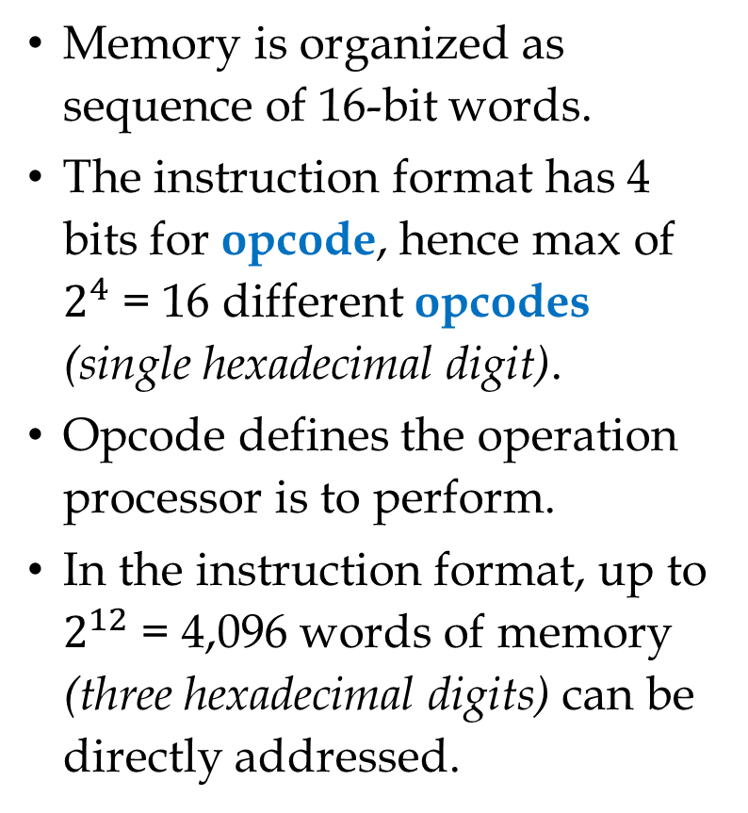
Example … (Cont.)
Memory is organized as sequence of 16-bit words.
The instruction format has 4 bits for opcode, hence max of $2^{4}$ = 16 different opcodes (single hexadecimal digit).
Opcode defines the operation processor is to perform.
In the instruction format, up to $2^{12}$ = 4,096 words of memory (three hexadecimal digits) can be directly addressed.

Slide 14
Example … (Cont.)
PC = 300 (first instruction address). The instruction (1940) is loaded into IR and PC is incremented.
First digit in IR indicate that AC is to be loaded from memory. Remaining three digits specify the address, 940.
Next instruction (5941) is fetched from location 301 and PC is incremented.
Old contents of AC and contents of location 941 are added and the result is stored in AC.
Next instruction (2941) is fetched from location 302 and PC is incremented.
Contents of AC is stored in location 941.

